Slide 1

FitQuest
Personal Productivity App
“Gamified Task Management”
Group 15: Jay Parikh, Sunny Yadav, Rushad Daruwalla

Slide 2
Github Repository
Github Link
Tech Stack:
Swift and UIKit
Firebase (Auth, Firestore Storage and Database)
FitQuest

Slide 3
What is FitQuest?
A gamified productivity app that helps users build better habits through:
Task Management
XP & Leveling System
Category-Based Organization
Progress Tracking
Visual Analytics
Target Users: Students, Young Professionals, Anyone seeking self-improvement.

Slide 4
Core Features
Calendar view:
Week-by-week task scheduling
Date selection & navigation
Real-time task updates
Task Management:
5 categories (Physical, Mental, Social, Creative, Misc.)
Custom & predefined tasks
Difficulty-based XP rewards
Progress Tracking:
Progress Tracking
Radar chart visualization
Level & tier progression

Slide 5
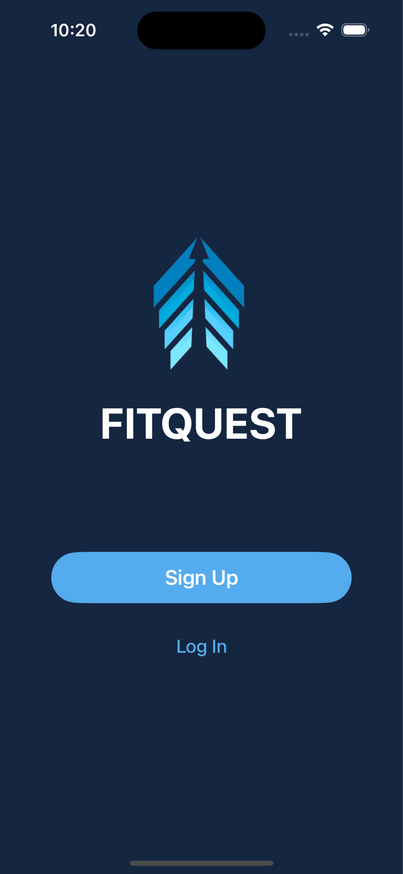
Authentication and Onboarding
Features:
Email/Password Authentication
Firebase Auth Integration
Secure user data storage
AI-generated user avatar
Flow:
Landing page
Sign Up / Login
Home Dashboard

Slide 6
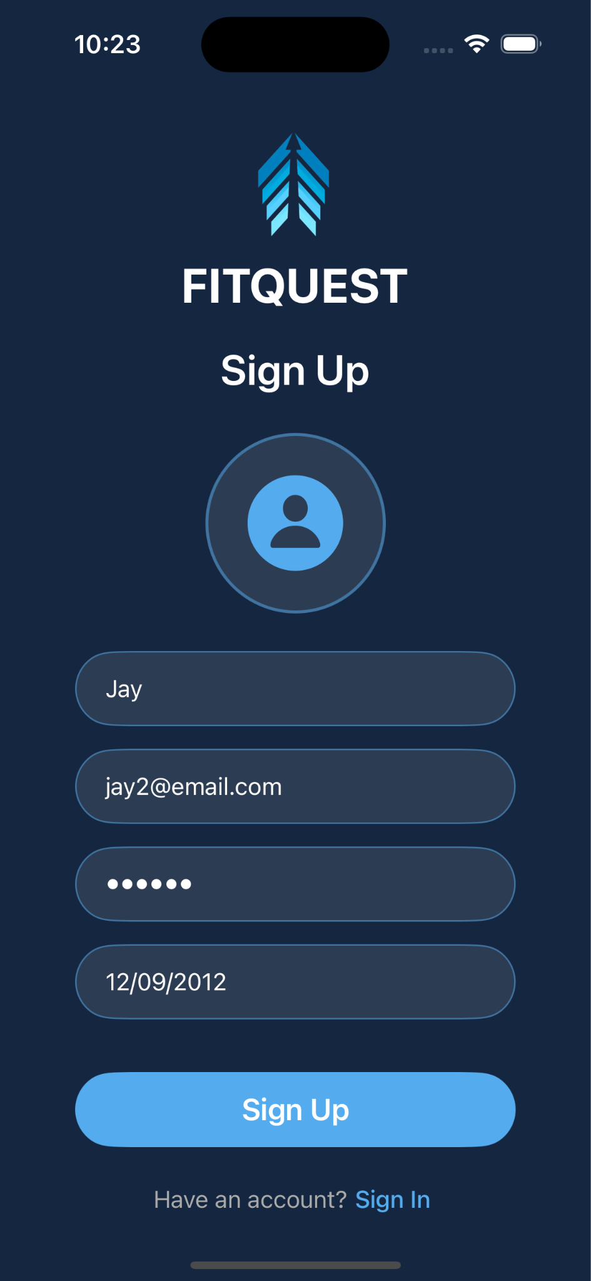
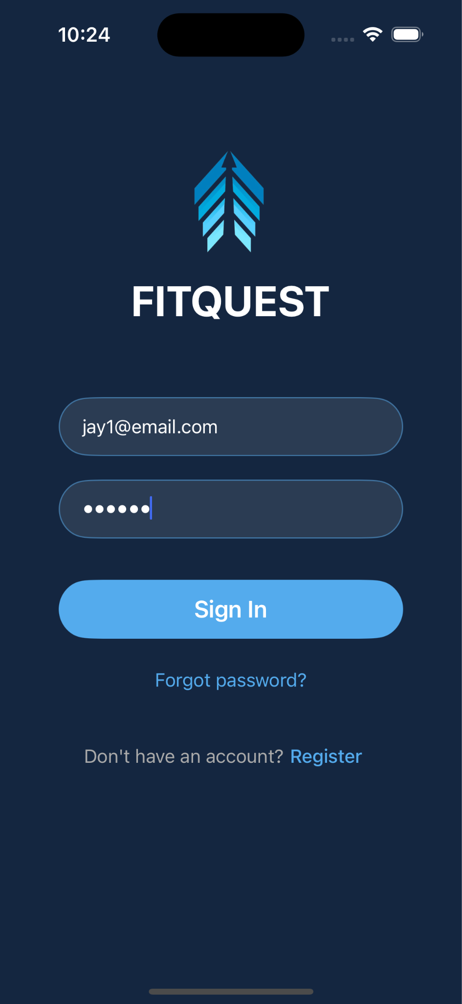
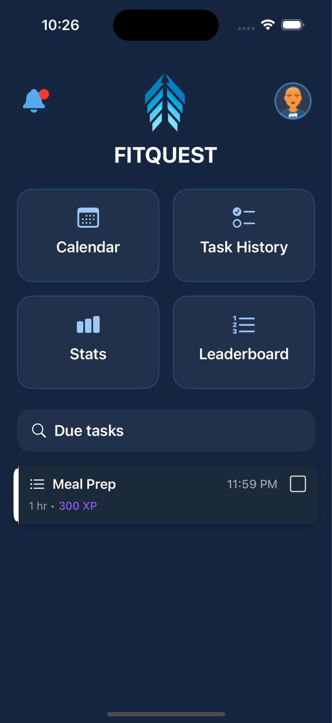
Flow of Logging In
or

Slide 7
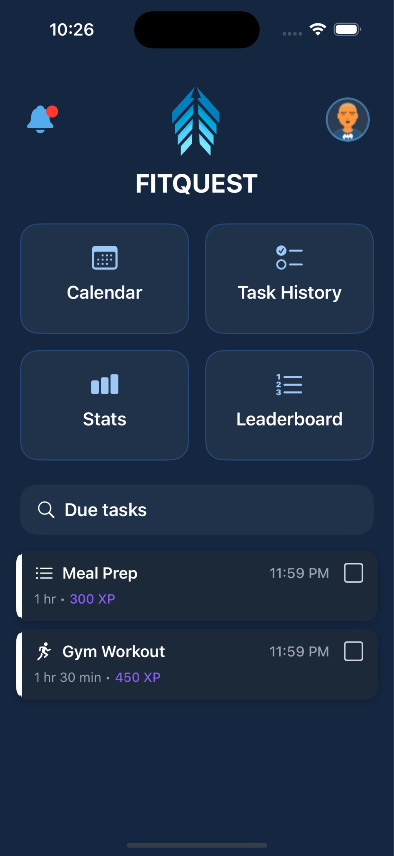
Home Dashboard
Features:
Quick access cards (4 sections)
Today's due tasks list
Search functionality
Notification center
Navigations:
Calendar
History
Stats
Leaderboard
Profile
Navigation cards

Slide 8
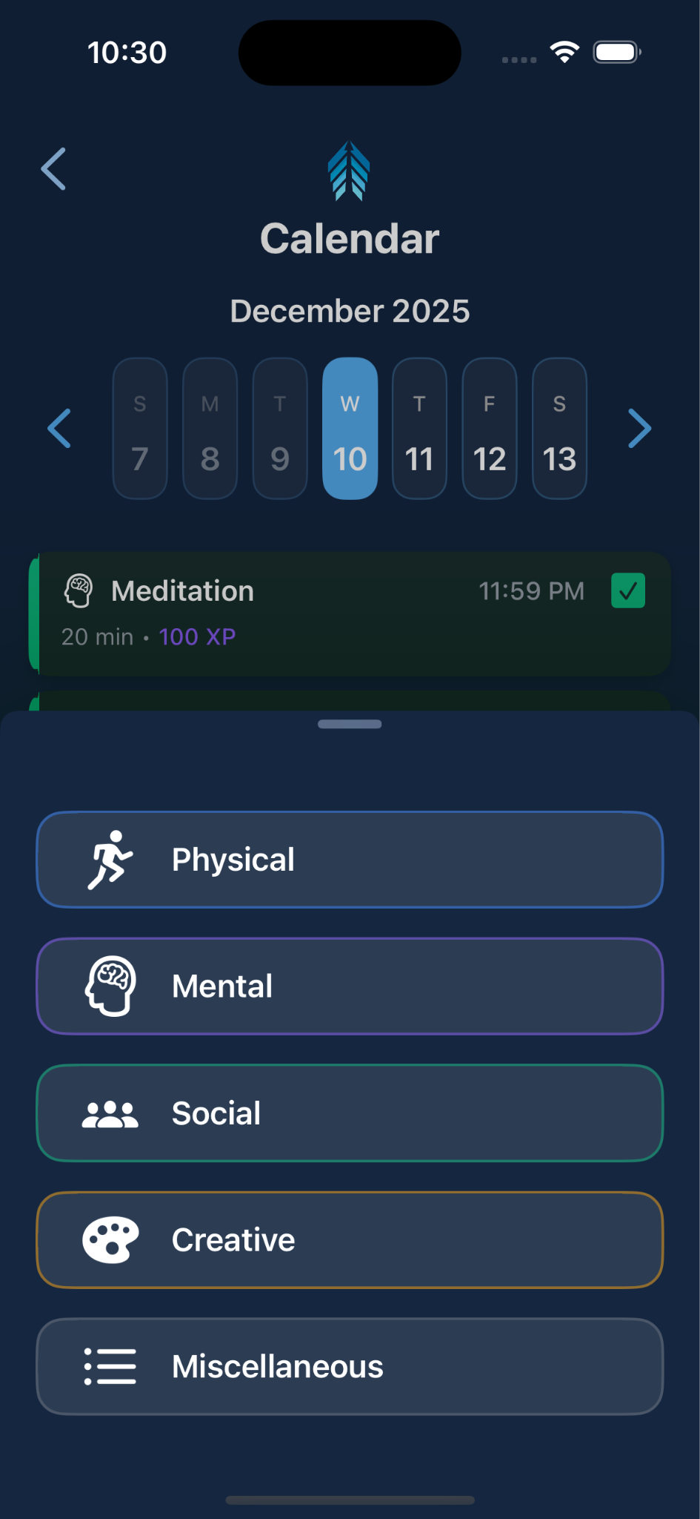
Task categories
There 5 defined Task Categories:
Physical
Mental
Social
Creative
Miscellaneous

Slide 9
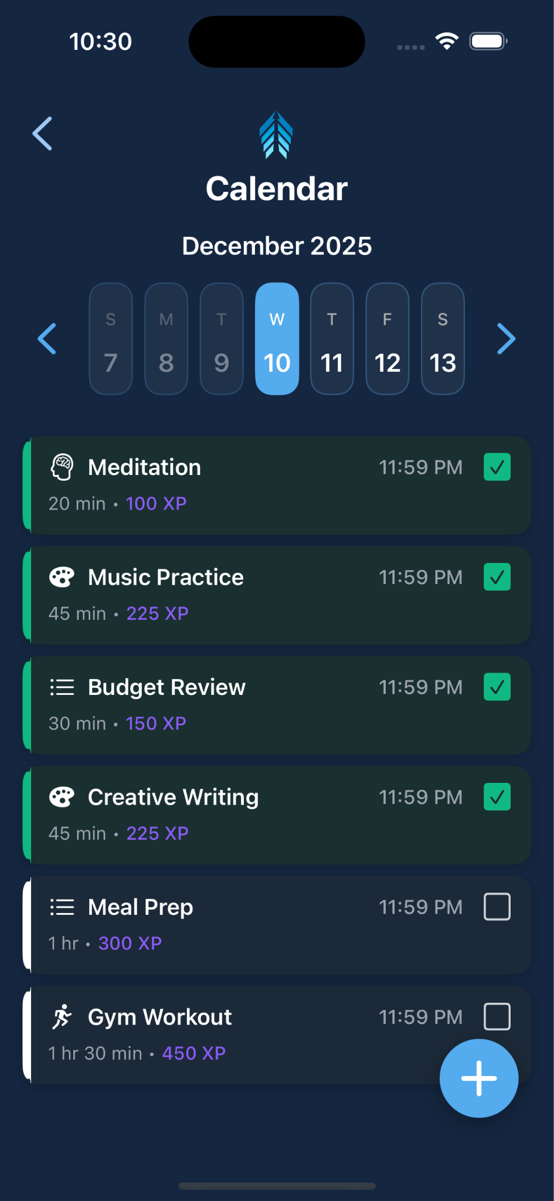
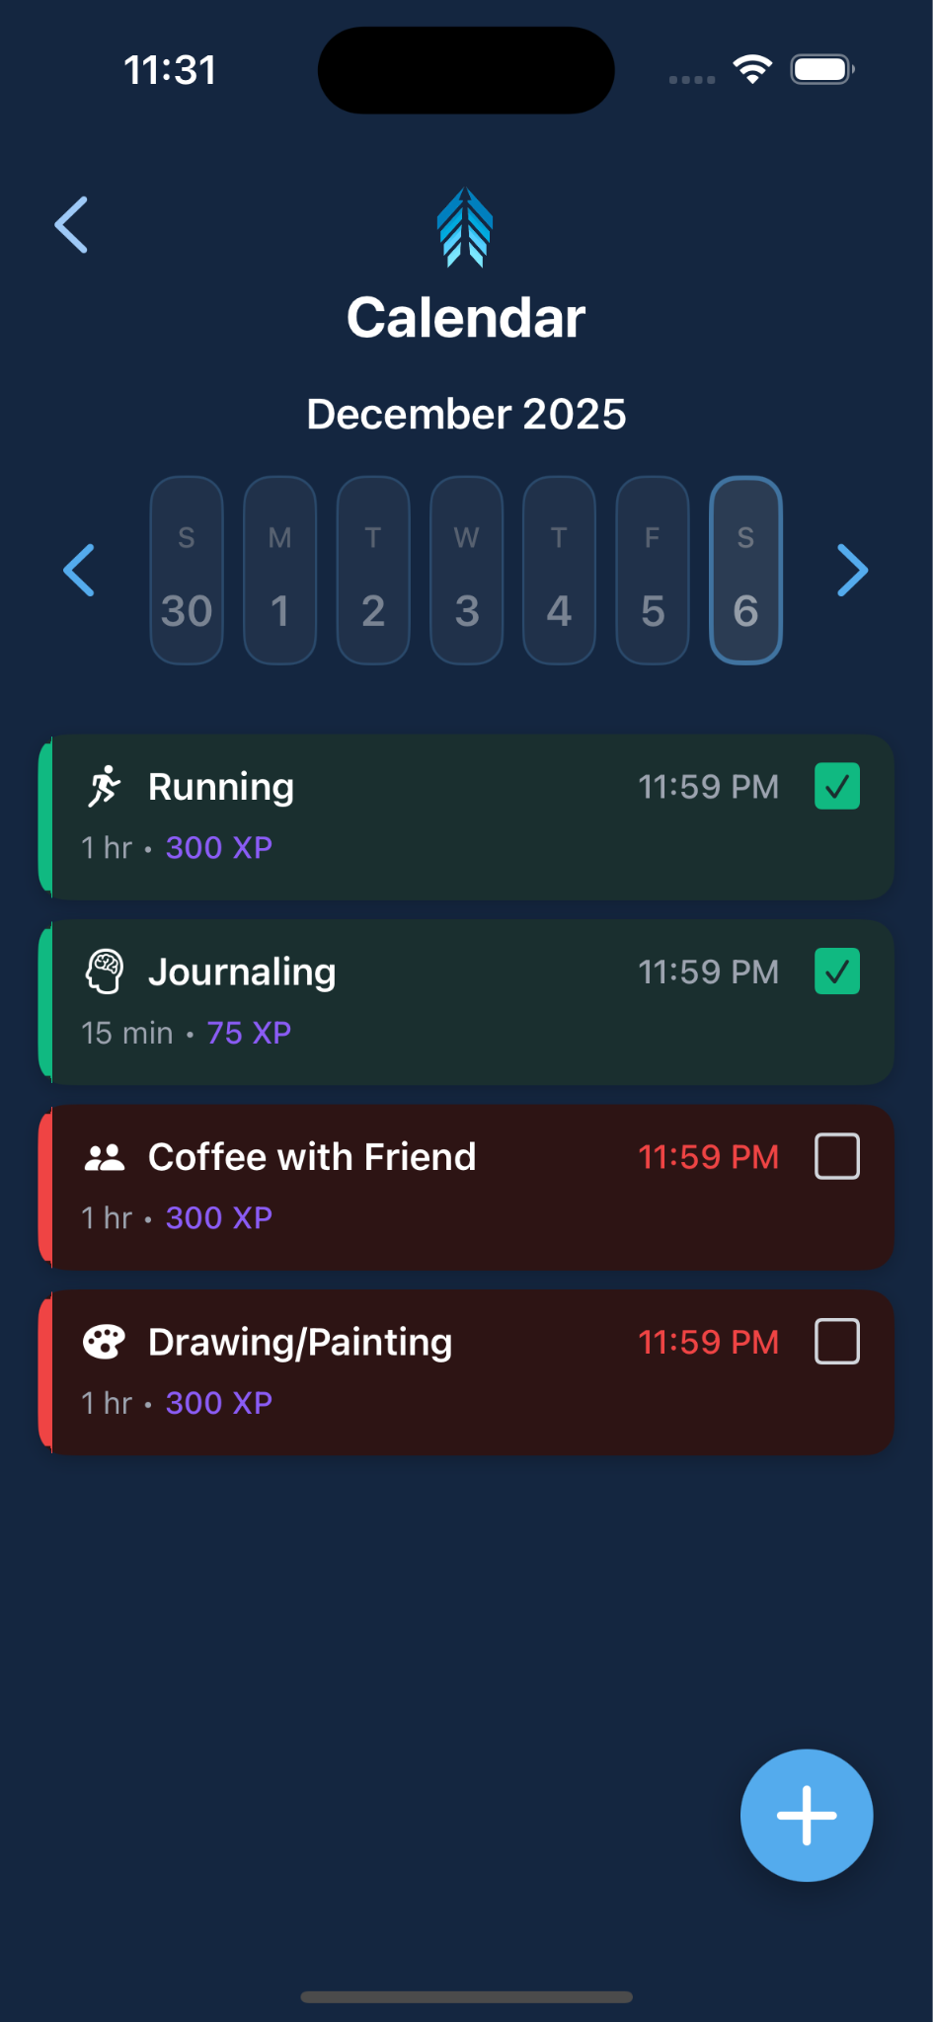
Calendar Screen
Features:
Week view with 7-day display
Previous/Next week navigation
Month/Year picker
Task list filtered by date
Real-time Firebase sync
Pull-to-refresh
Floating + button for new tasks
Swipe left to delete task
Task States:
Completed
Overdue
Pending

Slide 10
Task Creation
Tap on the Add ‘+’ button
3 - Step Process:
Select Category from the bottom sheet.
Choose Task type - predefined or custom
Fill details: Title, Duration, Difficulty, Due Date and Time, and Description.
Create Task

Slide 11
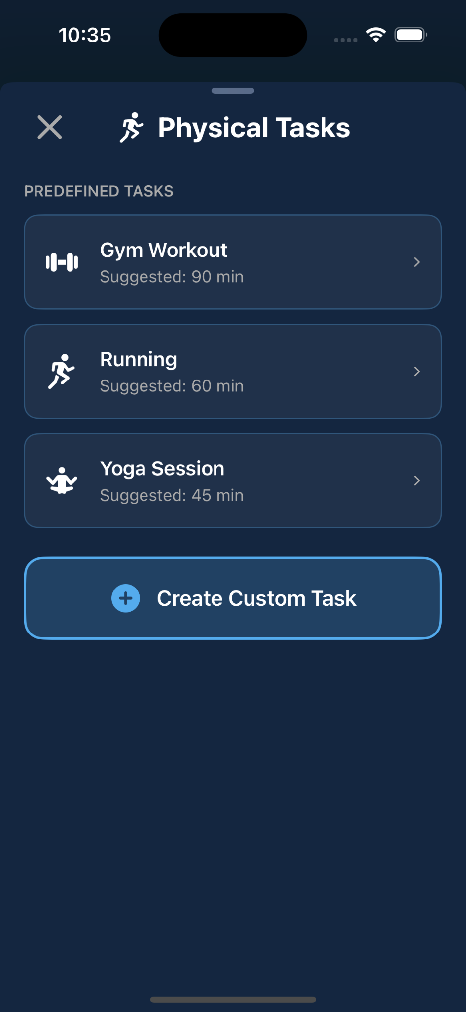
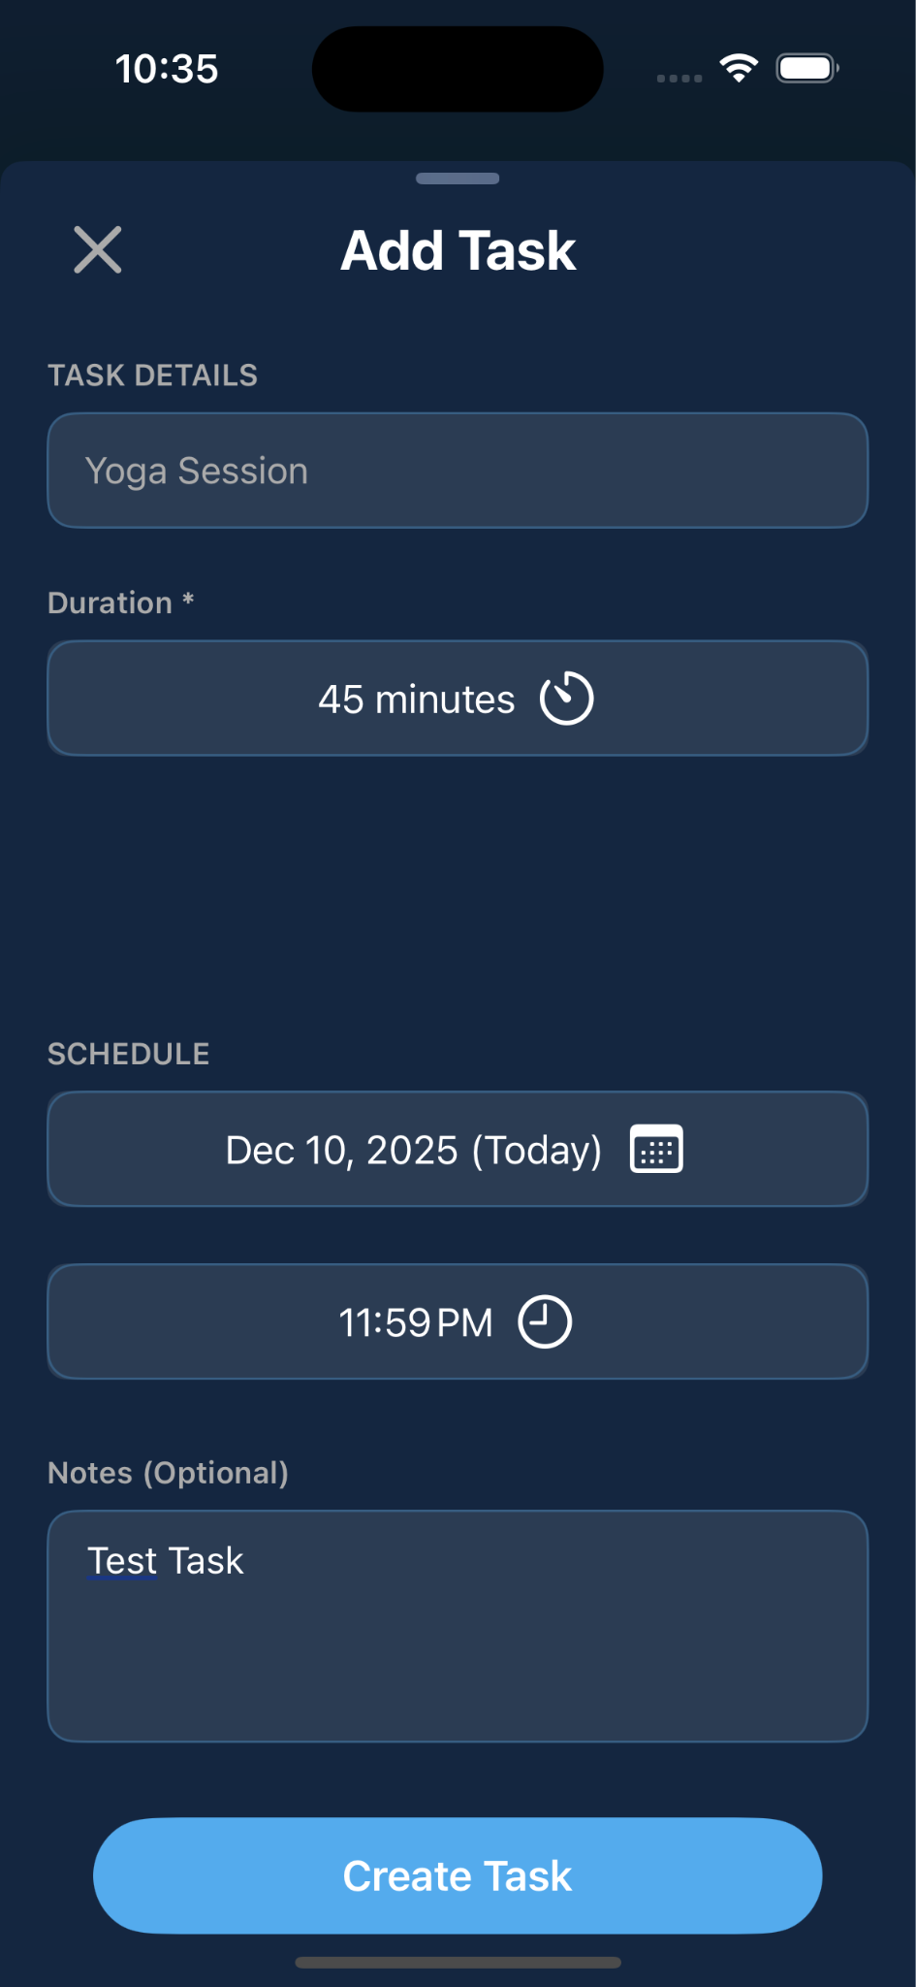
Task Creation flow

Slide 12
Task Completion
Features:
Tap checkbox to mark complete
Green toast with task name + XP
Visual state change (green)
Stats automatically updated
5 - Minute undo window:
Unmark within 5 minutes
XP deducted
Stats reversed
Red toast with -XP
Mark checkbox to complete task

Slide 13
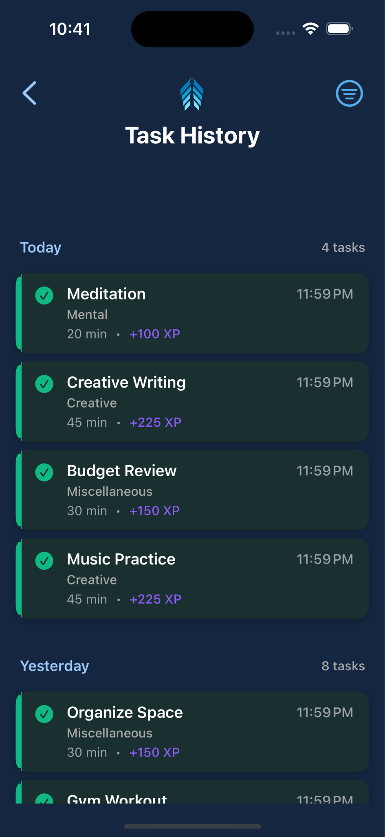
Task History
Features:
Date-grouped task list
Shows completed & missed tasks
Category filtering
Infinite scroll pagination
Task detail view
Visual Indicators:
Completed
Missed

Slide 14
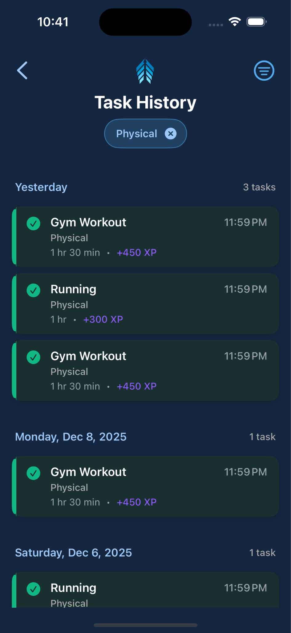
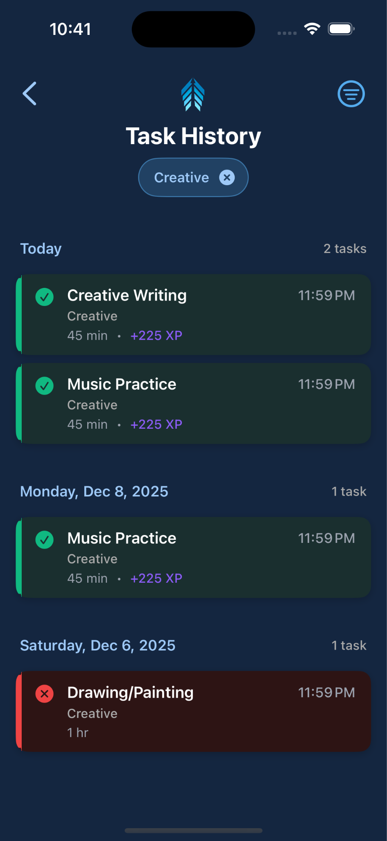
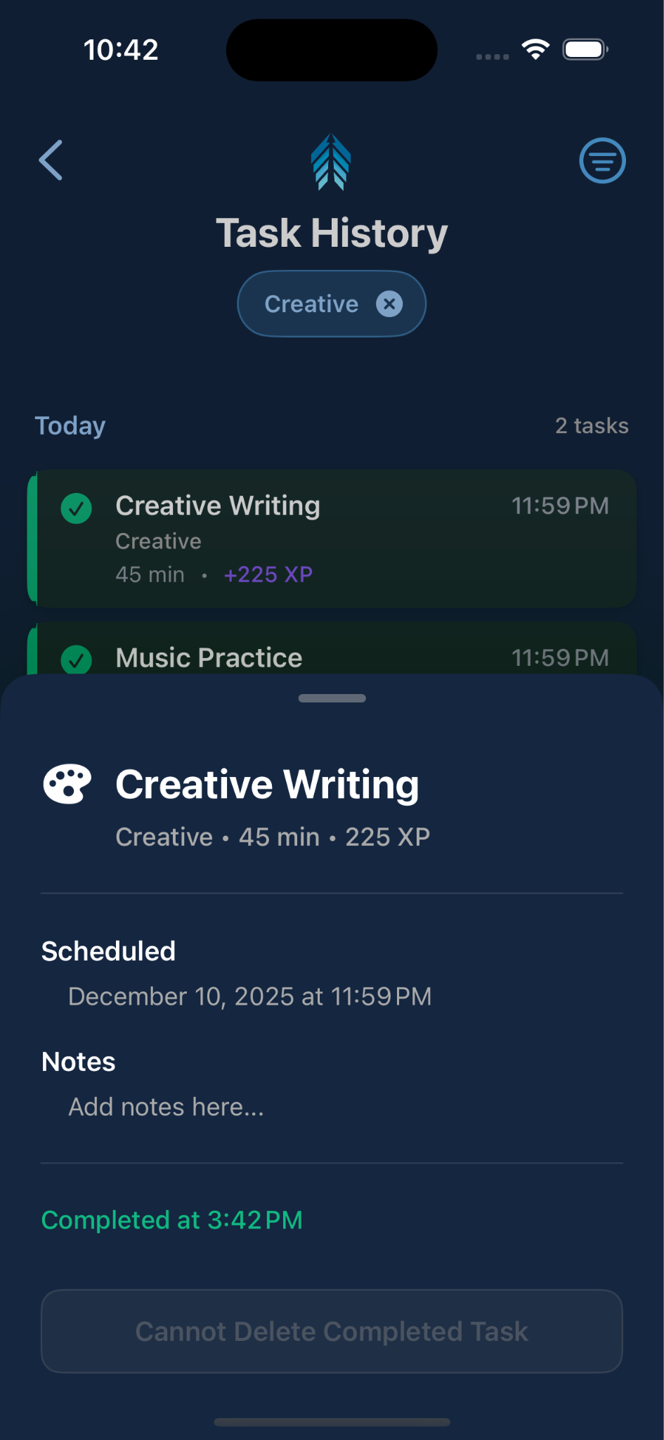
Task History Filters
On clicking a task cell

Slide 15
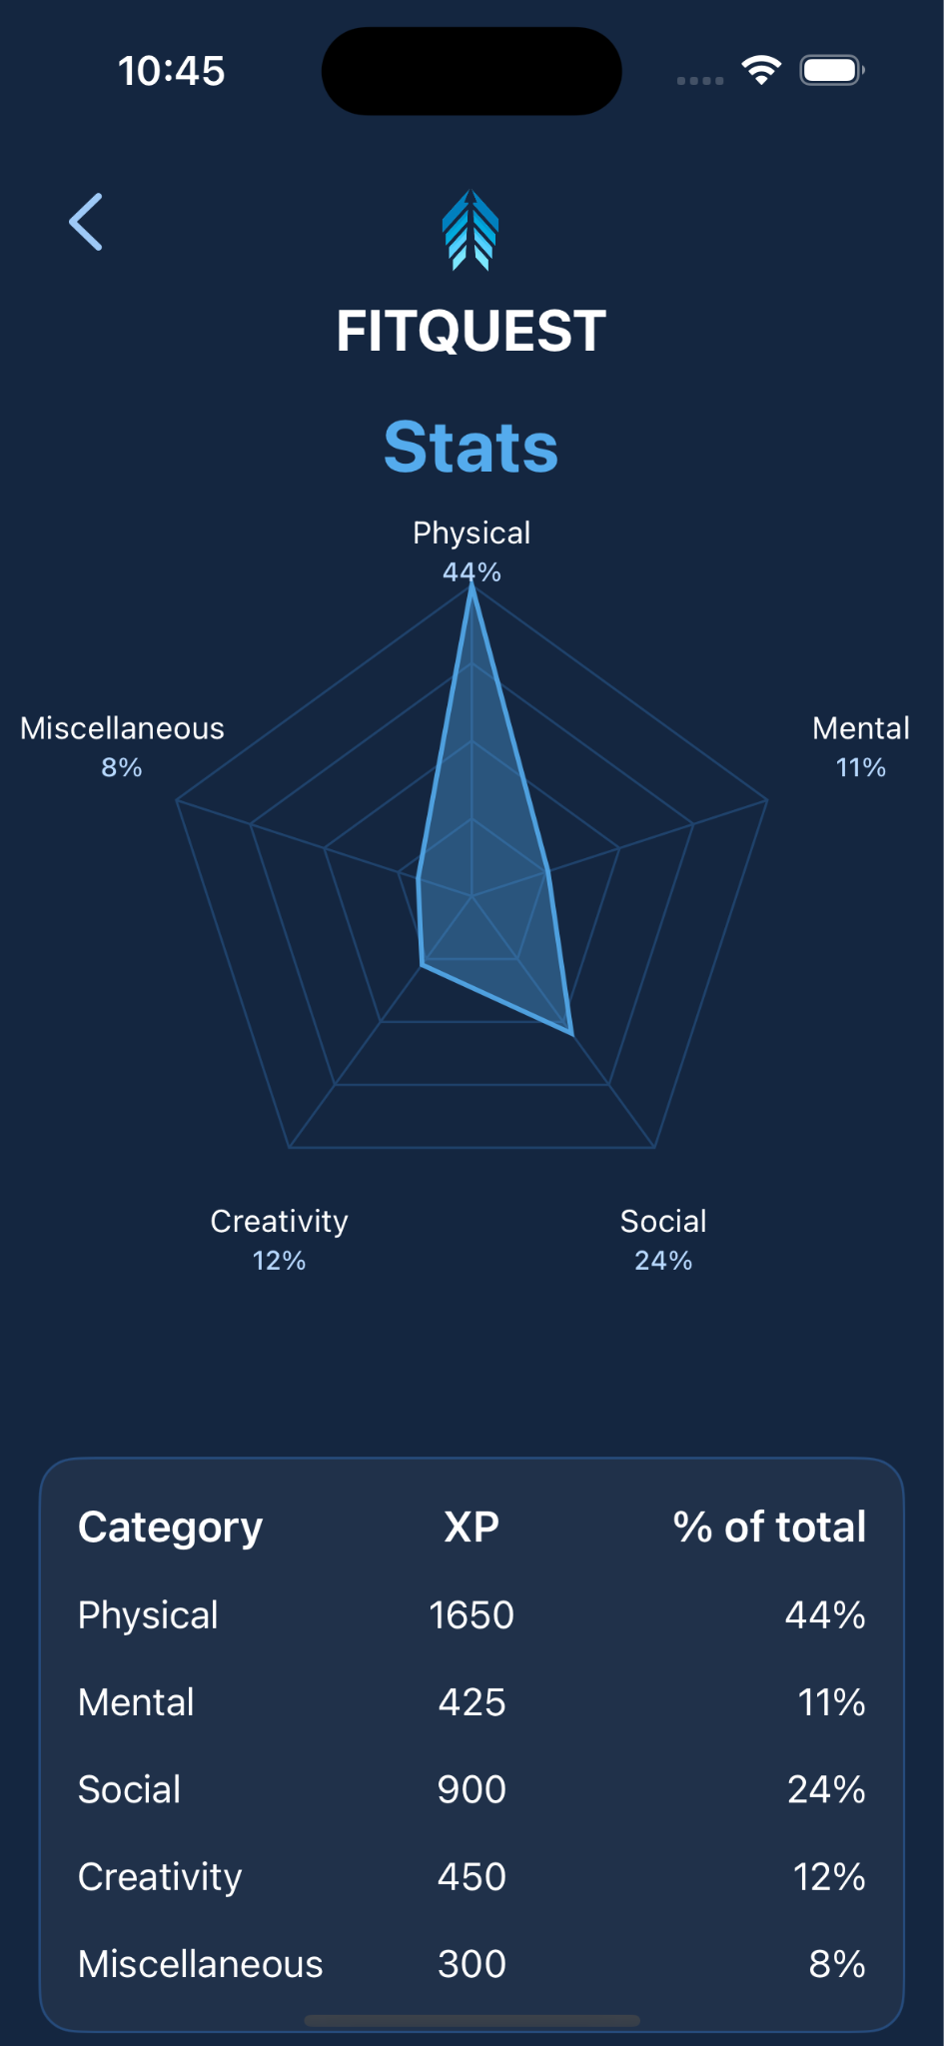
Statistics Dashboard
Radar Chart:
5-category XP distribution
Custom-drawn radar visualization
Real-time data from Firebase
Category Breakdown:
XP earned per category
Percentage distribution
Track Progress:
Overall Stats
Category-specific totals

Slide 16
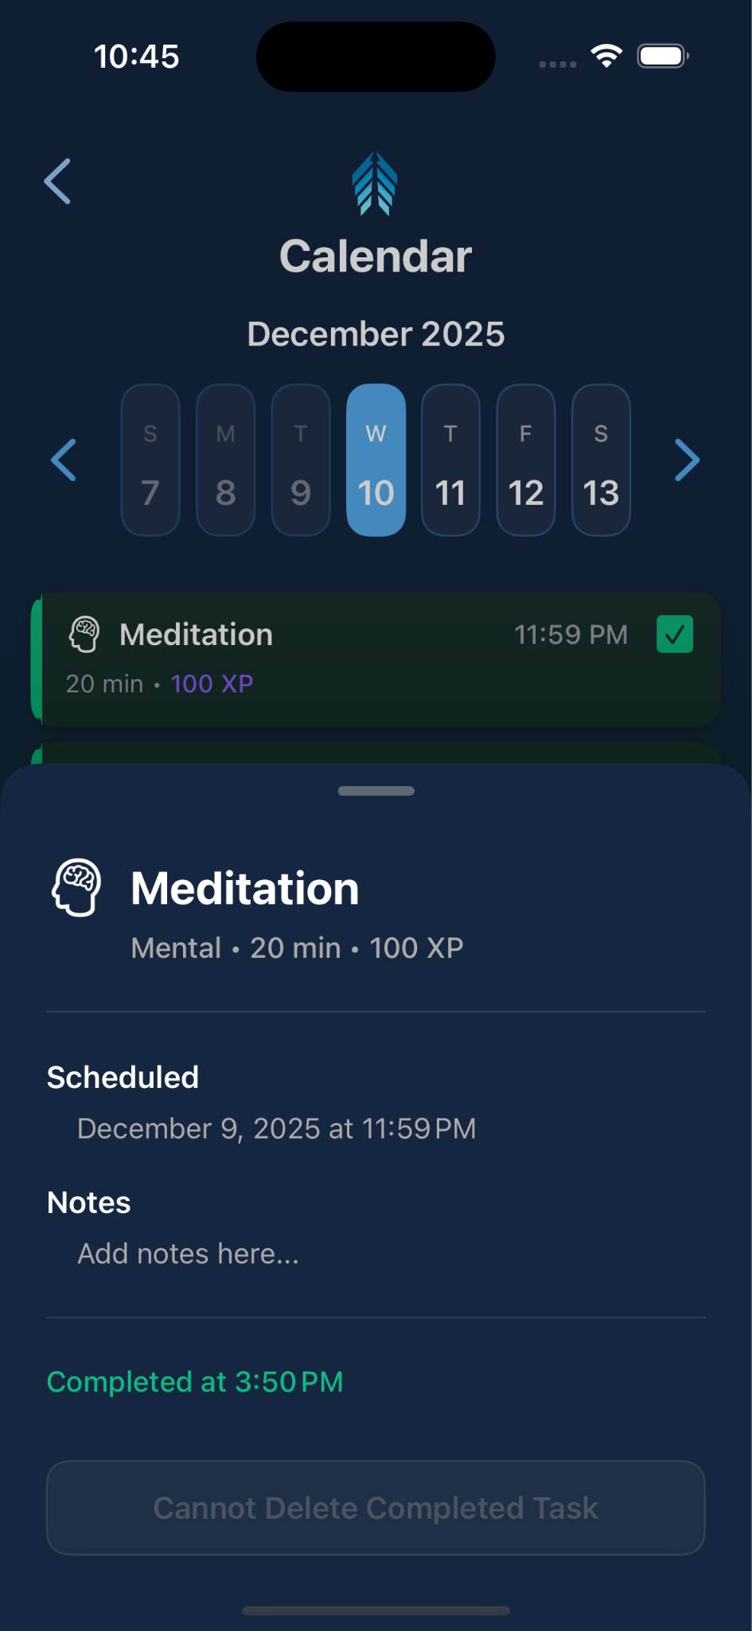
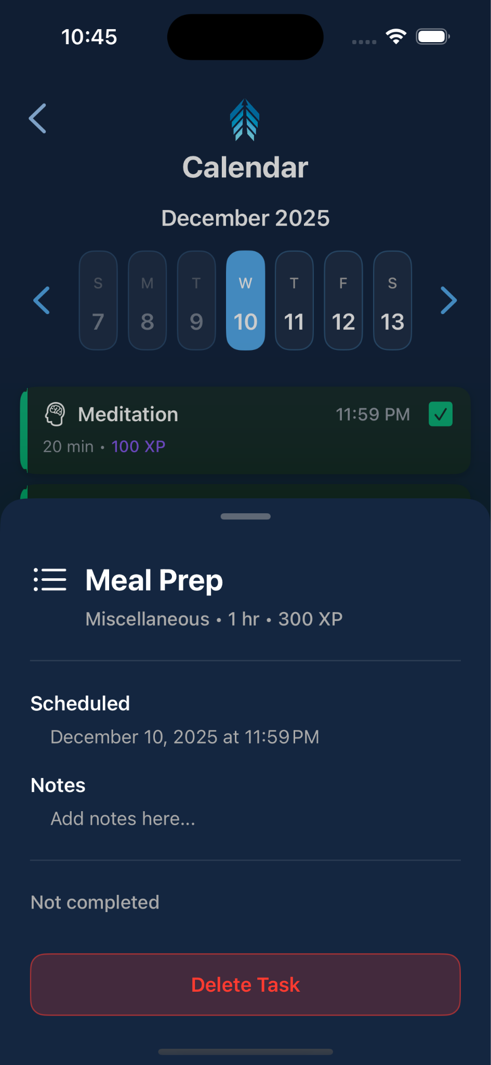
Task Detail View
Information Displayed:
Task title & category icon
Duration & XP value
Scheduled date/time
Notes (if any)
Completion status
Actions:
Delete Task
Close Task Details

Slide 17
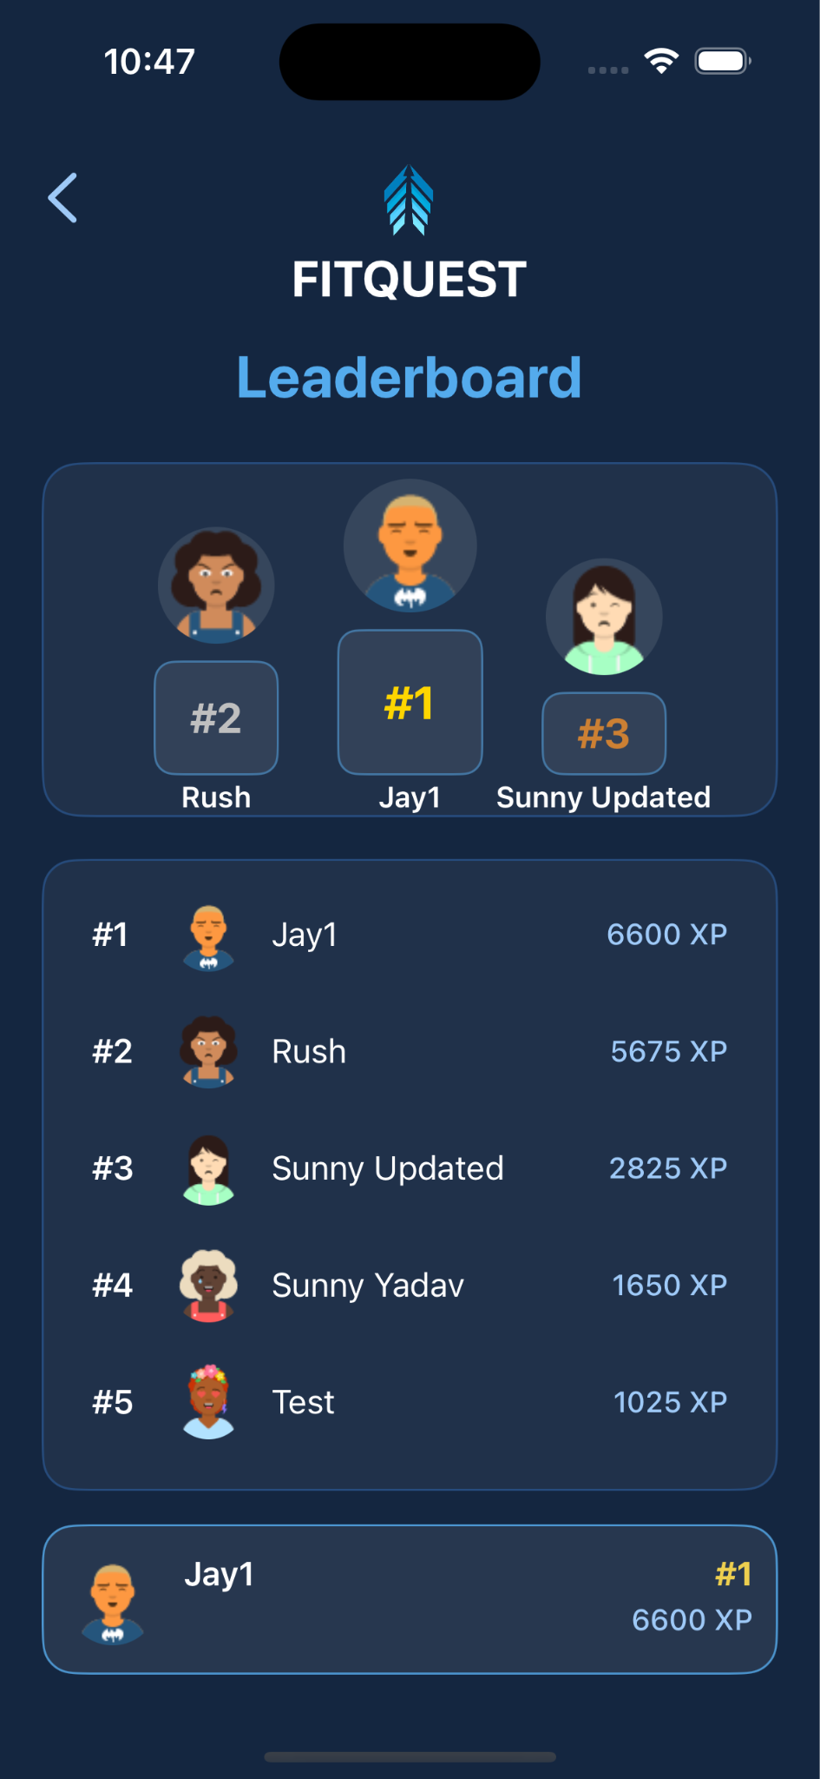
Leaderboard
Features:
Real-time data of all Users
Podium with top three performers
List of all Users by their XP
User’s current position

Slide 18
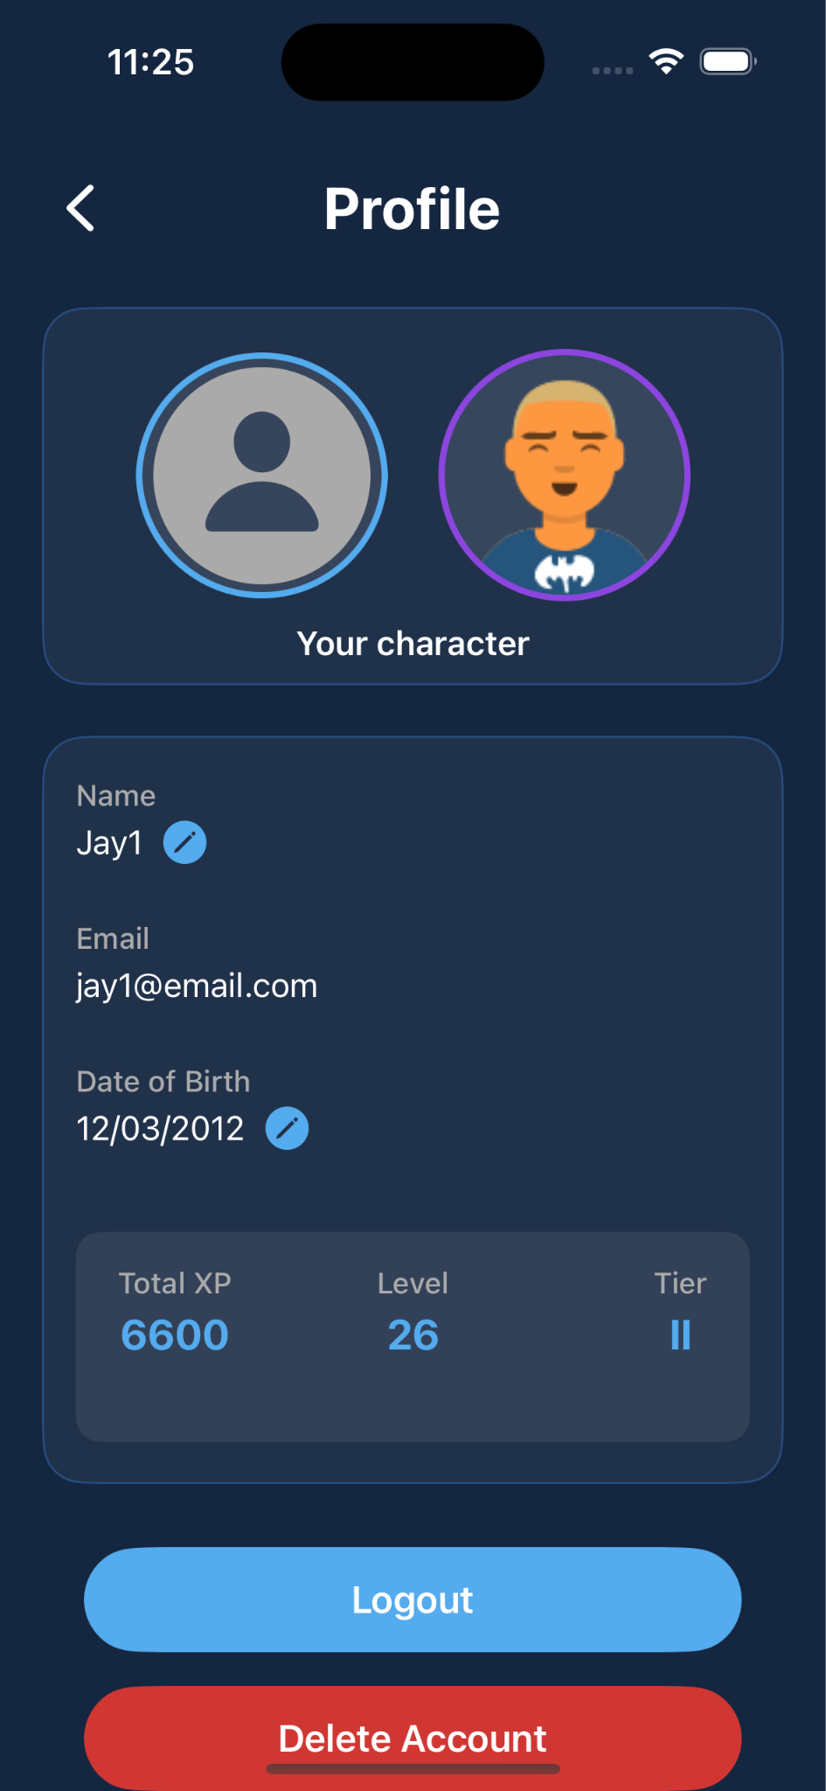
Profile
Features:
AI-generated character avatar unique to each user
Displays total XP earned, current level, and tier achieved
Editable user details with secure account management
Allows Logging out and Deleting Account

Slide 19
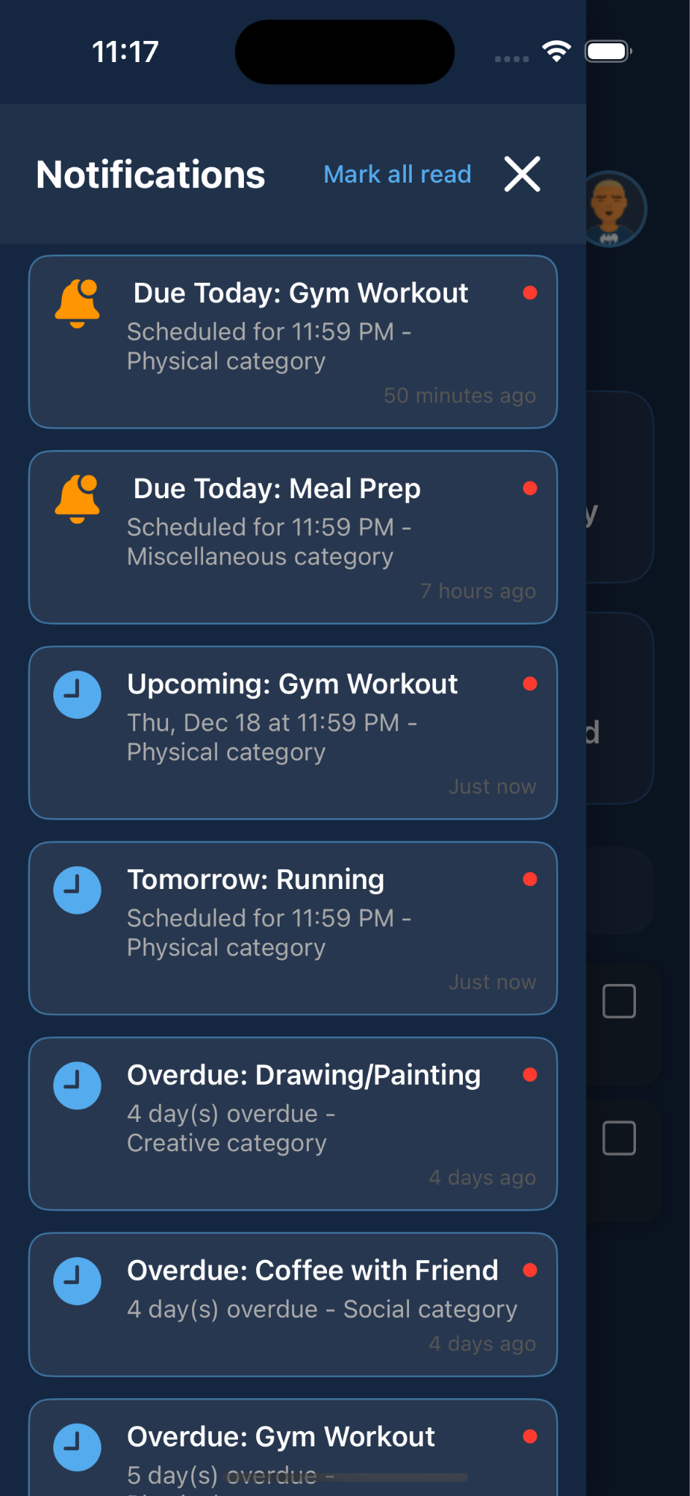
Notifications Drawer
Features:
Task reminders
Overdue task alerts
Mark as read/unread
Swipe to dismiss
Badge Indicator:
Red dot on notification bell
Shows unread count
Updates in real-time

Slide 20
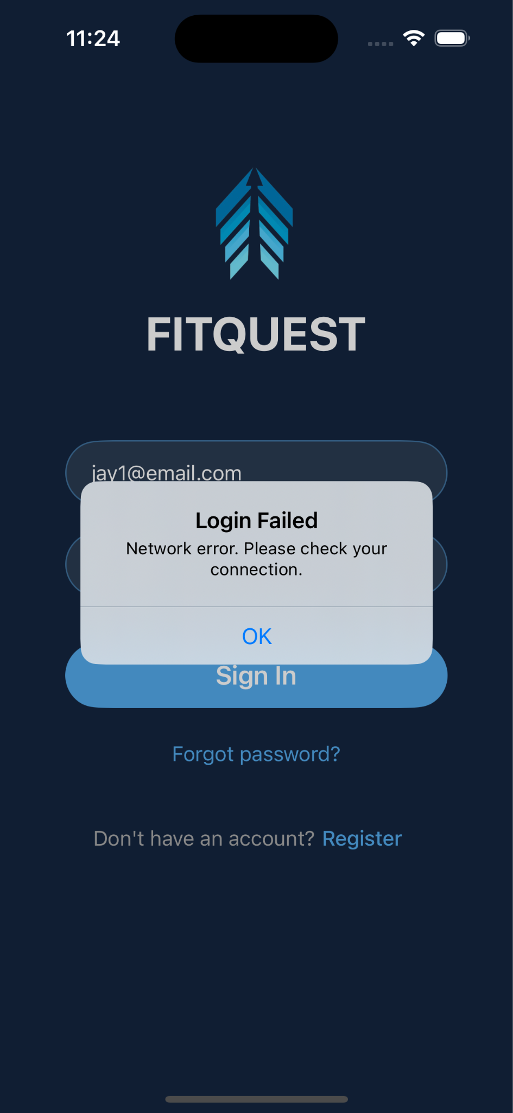
Internet Connectivity Alert
Network connectivity is monitored throughout the app, with graceful error handling that alerts users when offline and suggests checking their internet connection
Context-aware error messages distinguish between network issues, permission errors, and timeouts, providing clear guidance for resolution

Slide 21
Created By
Jay Parikh, Rushad Daruwalla & Sunny Yadav

